Slide 1

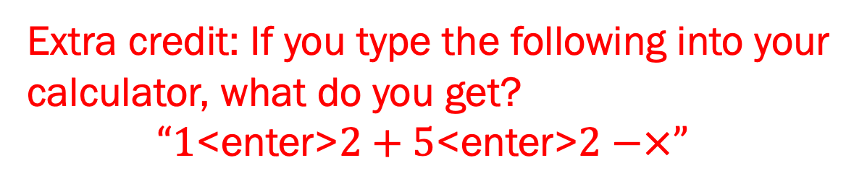
I’m Not Teaching You To Program!
Extra credit: If you type the following into your calculator, what do you get?
$“1$<enter>$2+5$<enter>$2−×”$
Todd Zimmerman
University of Wisconsin – Stout
Menomonie, Wisconsin
AAPT Summer Meeting
July 22, 2019
Inspiring Innovation. Learn more at www.uwstout.edu
Notes:
(1+2)*(5-2) = 3*3 =9
Teach at a 4-year public university. PUI with ~ 10,000 students
Brand new physics “major” (1 year old) – no graduates yet
Most intro courses support several engineering programs

Slide 2
PICUP
Lowering the barriers for the integration of computation into your curriculum
Notes:
PICUP is a community of people focused on providing support to integrate computation into your curriculum

Slide 3
Outline
Faculty Hurdles Encountered
Student Hurdles Encountered
How to Fail at Integrating Computation
Notes:
This is about my experience

Slide 4
Departmental Norms
Some faculty opposed to computational modeling in introductory courses
”Not your job”
Notes:
Senior faculty opposed to teaching programming
Status as brand new faculty

Slide 5
Not My Job
It’s not my job to teach students how to….
switch a calculator to radians
access material in the LMS
solve a quadratic equation
integrate a polynomial
write a paper
modify a computer program

Slide 6
Implementation
I was expecting them to program
Activities not well implemented
Notes:
I didn’t know how to teach programming

Slide 7
Myth of the Lone Professor
“I’ve got a PhD…”
“I’ve been teaching physics for a number of years…”
“I’ve read the literature…”
“I know how to program…”
I was just as much of a hurdle
Notes:
…so I should know how to do this
I was just as big of a impediment as the faculty telling me not to include programming. Also, I didn’t know how to counter their arguments

Slide 8
It’s All About the Community
Why should we include computational modeling
Reasons to take to colleagues
How can we make modeling meaningful to students
How to go about incorporating computation into classes
Link to reports on PICUP website
Notes:
The PICUP community helped me figure out my reasons for why computational modeling is so crucial to learning physics in this modern era. The JTUPP (Joint Taskforce for Undergraduate Physics Programs) and AAPT Recommendations for Computational Physics in the Undergraduate Physics Curriculum
gave me arguments to take back to my colleagues.
I learned to focus on my learning objectives and create computational assignments that focused on those objectives -> I realized I didn’t really care if they could write a program from scratch, just whether they could work with a model to develop insight and extract information
I learned about websites like Trinket, which helped me create and distribute assignments

Slide 9
I’m Not Teaching You to Program
Students see programming as part of CS
Students don’t see how it is relevant
Students don’t see how it helps them to understand physics
Students see it as extra work

Slide 10
“Why are we learning programming?”
Students haven’t seen this in other physics classes
Don’t call it programming
Computational modeling
Don’t say “we are programming” or “we are coding”
“We are modifying code”

Slide 11
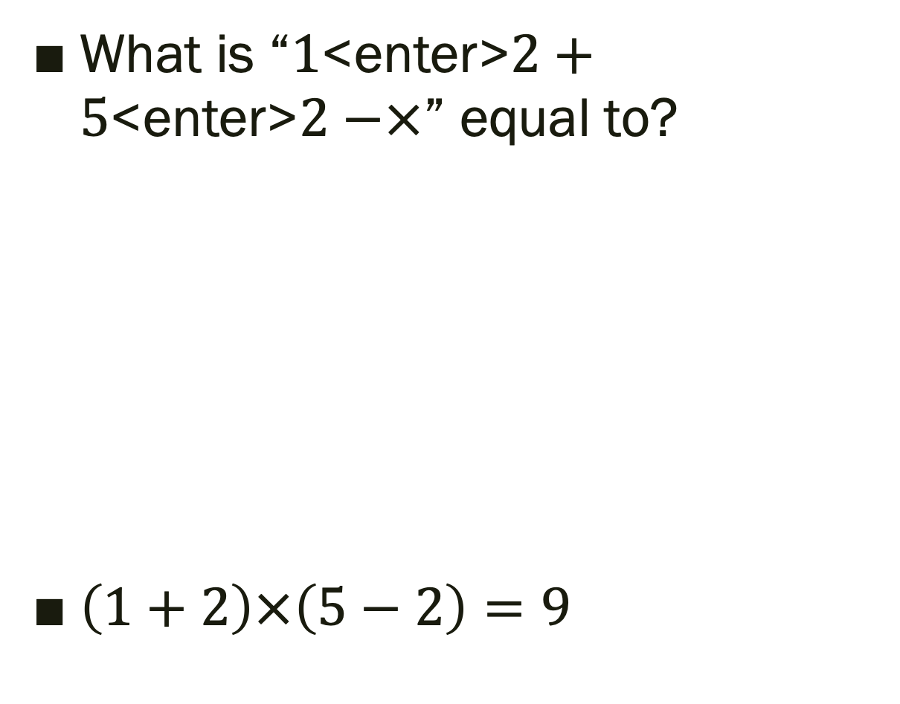
What is “$1$<enter>$2+5$<enter>$2−×$” equal to?
$\left(1+2\right)×\left(5−2\right)=9$
Notes:
If you can solve this you are probably at least my age or older
Jan Lukasiewicz, a polish logician, invented Polish notation in 1924
Operations precede the their operands
Image: https://en.wikipedia.org/wiki/Polish_notation

Slide 12
That’s not programming!
This isn’t programming…
THIS is programming…
Notes:
https://archive.org/details/Apple_II_6502_Assembly_Language_Tutor_Richard_Haskell_1983

Slide 13
“This is a physics course”
Show how learning objectives tie to computational modeling
Make it relevant
Long term projects
Include exam questions
Talk about computational thinking
Computational Thinking in Introductory Physics
Notes:
Mention Chris Orban’s paper on computational thinking -> QR code
Chris Orban, Richelle Teeling-Smith
https://arxiv.org/abs/1907.08079
https://lorenabarba.com/blog/computational-thinking-i-do-not-think-it-means-what-you-think-it-means/

Slide 14
”I should be learning physics”
Solve problems that aren’t possible otherwise
Electric field of a rod of charge not on axis or perpendicular to axis
Show things that aren’t intuitive
Field between two charged plates
Notes:
Get graphics for this

Slide 15
A Short History of Computational Modeling
Hand-written math: ~ 3000 BCE - …
Logarithm Tables: 1614 to ?
Slide Rules: 1620 to 1975
Handheld Calculator: 1972 - …
Personal Computer: 1977 – …
Python: 1989 - …
Notes:
Log Table: By Henry Briggs - http://www.pmonta.com/tables/logarithmorum-chilias-prima/index.html, Public Domain, https://commons.wikimedia.org/w/index.php?curid=43431356
Slide rule: By teclasorg - Flickr, CC BY-SA 2.0, https://commons.wikimedia.org/w/index.php?curid=1173203
Calculator: By Rama, CC BY-SA 2.0 fr, https://commons.wikimedia.org/w/index.php?curid=29591429
Python Logo: www.python.org [GPL (http://www.gnu.org/licenses/gpl.html)]

Slide 16
“Just one more thing to learn”
Start small
Modify working code or minimally working code
Provide resources
Video tutorials
Online courses in Python
Provide timely feedback
Don’t be afraid to “give them the answer”
Notes:
https://trinket.io/todd_zimmerman_phd_gmail_com/courses/introduction-to-glowscript-picup-workshop#/getting-started-with-glowscript-vpython/running-code-in-trinket

Slide 17
What if I fail?
Too much content to cover
Colleagues don’t know Python
Departmental norms
Notes:
Doing hard things is how I remind myself of frustrations students are feeling with new material
Image: https://miro.medium.com/max/1214/1*aCfvyxPjVu1RDkewpy52wA.jpeg

Slide 18
Content Coverage
3-credit Statics course
No lab or discussion
Talk to ”downstream” instructors and departments
Does ”coverage” equal “understanding”?
Notes:
I don’t have a clear picture how I would make this work in the future but…

Slide 19
Lack of knowledge
Colleagues don’t use Python
Send them to FDW
Co-teach a course
Give them your intro material
Notes:
Encourage them to become part of the PICUP community

Slide 20
Departmental Norms
Serendipity
Keep trying when circumstances change
Mentor new faculty
Set the new norms
“Change happens one retirement at a time”

Slide 21
Join PICUP
Lowering the barriers for the integration of computation into your curriculum
Join the conversation and ask your questions on Slack:
Notes:
https://www.compadre.org/PICUP/community/

Slide 22
Thank You
Thanks to the UW-Stout Office of Research and Sponsored Programs and to the Department of Chemistry and Physics for financial support
https://github.com/zimmermant/talks/tree/master/AAPT_2019-Summer
Notes:
https://github.com/zimmermant/talks/tree/master/AAPT_2019-Summer

